Slide 1

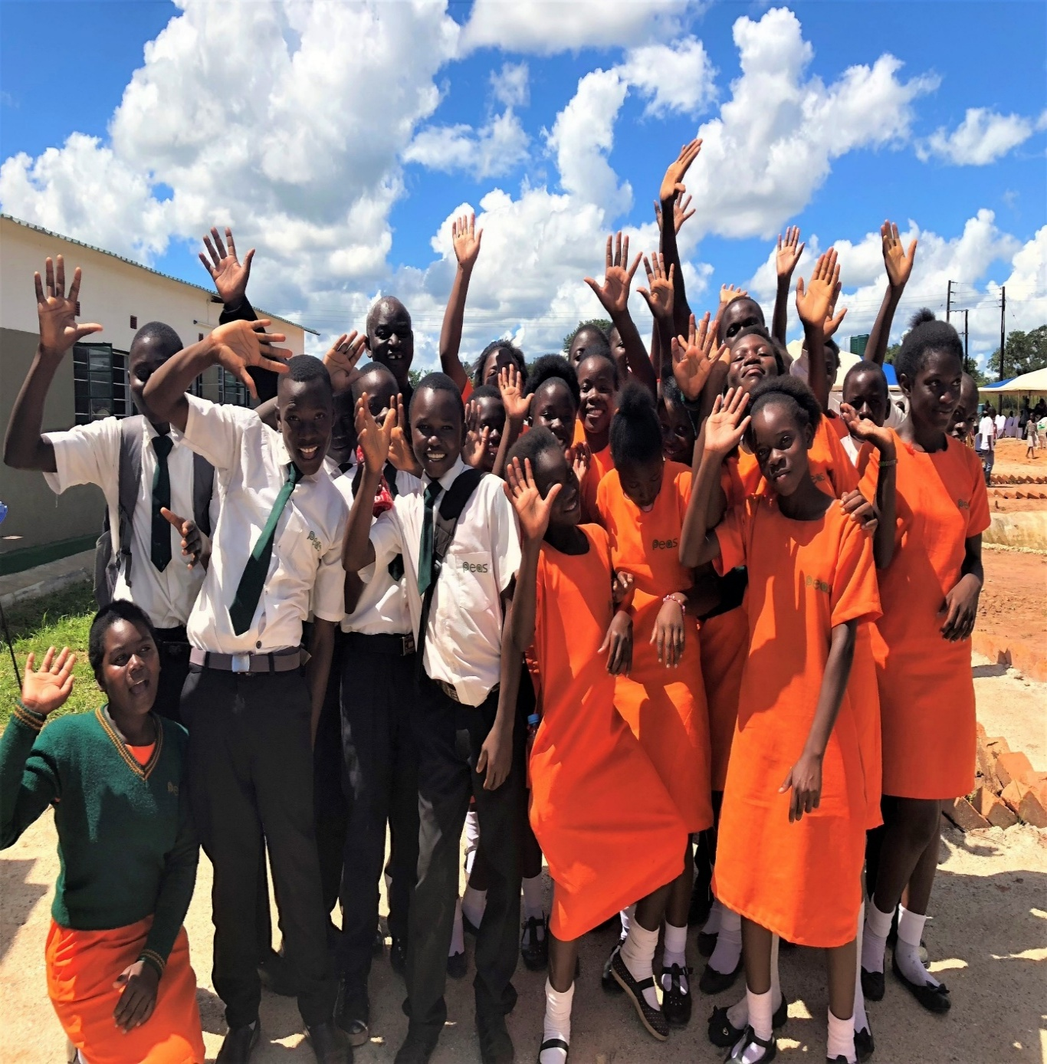




Senior School Support Officer
Candidate Pack
Our Mission
To expand access to sustainably delivered quality secondary education across Africa
www.peas.org.uk

Slide 2
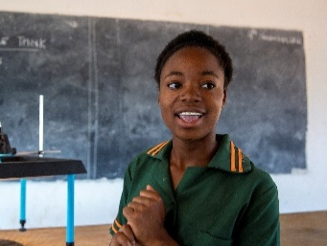
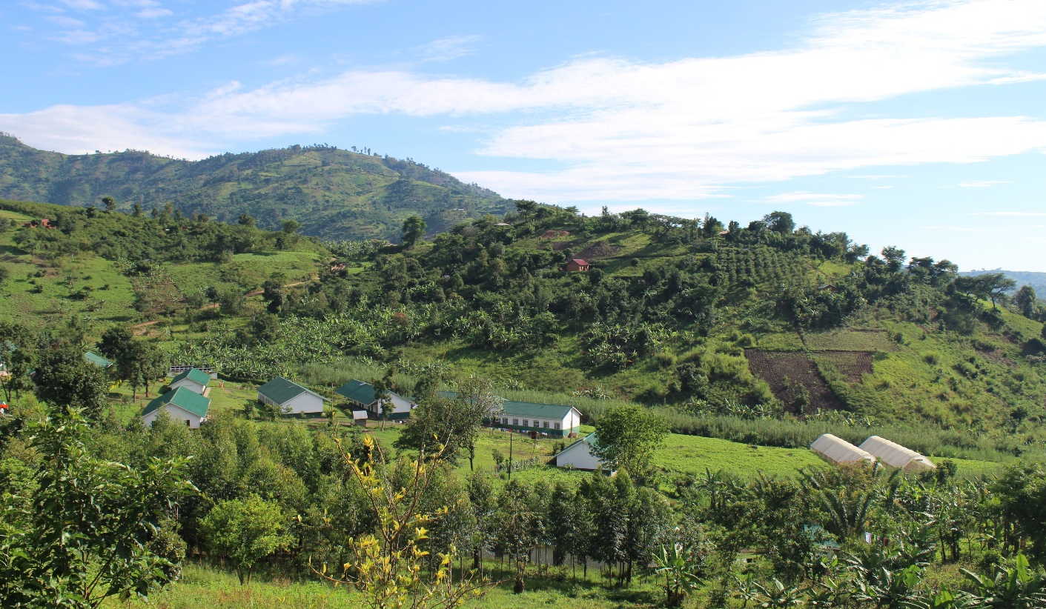
About us
PEAS (Promoting Equality in African Schools) is a not-for-profit that expands access to inclusive, quality secondary education across Sub-Saharan Africa. Our vision is a world where all children enjoy an education that unlocks their full potential. At the heart of our work are the 38 PEAS schools across Uganda and Zambia, where we deliver a high quality, low cost education in hard-to-reach communities. We draw on this experience to work hand in hand with governments so all young people can learn in a safe, inclusive environment. That means each year we support over 200,000 young people, in marginalised communities across Uganda, Zambia and Ghana. Our award-winning programmes are designed and delivered by Africans for Africans. Evidence shows our students come from poorer households and make faster learning progress. And our girls are more confident and better equipped for life after school. It’s an exciting time for PEAS. Our reach and impact is growing rapidly; we support 10x the number of students we did 5 years ago, we are building more schools and have expanded into new countries Our strategy is focused around a period of rapid growth. During this period, we aim to grow our school networks to double their size, launch in a new country and expand our wider impact by strengthening education systems. To be achieve this, we need to be working as efficiently and effectively as possible. We are looking for an Senior School Support Officer (SSSO) that can help us do this so that we can work towards achieving our exciting and challenging ambitions.

Slide 3
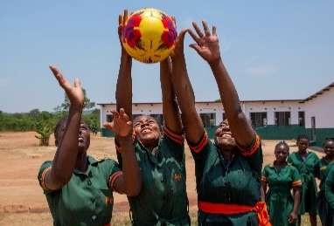
The Opportunity
.
Role and department | Senior School Support Officer, School Network
Contract | Fulltime
Compensation
Location | Mayuge, Kumi and Amuria
Start date | 1st August 2026
About PEAS Technical Team
PEAS is an international education not-for-profit with the mission to ‘expand access to sustainably delivered, quality secondary education across Africa’.
Since 2008, PEAS has built and operated high quality low-cost not-for-profit secondary schools in close partnership with government in communities where there is urgent unmet demand for secondary education. We currently run 30 secondary schools in Uganda, serving over 17,400 students.
After a number of rigorous external studies in recent years, we know that our school model works. In Uganda, PEAS students are from the poorest communities and have worse primary school exam results than average. However, once they enrol in a PEAS school, they go on to make faster academic progress than their more privileged peers. Importantly, this is achieved at a lower cost per student than in other school types.
The Opportunity
This is a key role at PEAS. The Senior School Support Officer provides direct support to schools and is responsible for improving performance in partnership with school staff. Success in this role requires someone who enjoys building relationships and mentoring others. You will need a clear understanding of what makes a great school and a strong commitment to delivering that for every PEAS student. You should be a respected educator whose judgement is trusted by staff and communities, and who is willing to make difficult decisions to uphold the PEAS mission and approach in every school and classroom. As this is a field-based role, you should be committed to working closely with schools and providing practical, hands-on support.

Slide 4
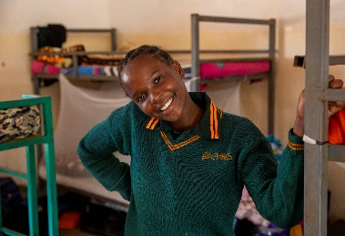
Responsibilities of the Role
The Senior School Support Officer will provide direct support to schools and is responsible for improving performance in partnership with school staff. Specific responsibilities may adjust depending on the specific background of the successful applicant. 1. School supervision School impact: Fully accountable for driving performance across Access, Quality and Sustainability in a cluster of 3-5 PEAS schools, line managing the School Leaders of each school and sharing their goals. School compliance: Ensure that schools are operating in accordance with PEAS and GoU policies. Performance management: Work alongside the Head of School Network to deliver annual performance appraisal of school leaders. 2. School support Build a strong positive cluster culture where all schools identify and are proud to be part of their cluster, promoting healthy relationships, collaboration and support to one another. Deliver high quality coaching to school leaders and training for teachers. Coordinate all support from other teams within PEAS Country Office, ensuring that support is delivered when it is needed but is never a distraction from the key activity of educating our students. Support school leaders to set, review and implement school improvement plans. Support schools with teacher recruitment and deliver high quality teacher inductions Interpret and use school-level data to provide relevant and practical support to schools including how to use the functionalities of their School Information System effectively. Conducting lesson observations alongside school instructional leadership teams and provide high quality feedback and action steps which are routinely followed up. Responsible for ensuring key communications are shared between the schools and country offices Serve as the Child Protection Focal Person for their cluster, delivering child protection training at school-level and leading investigations and case management. 3. Representing PEAS in our schools and communities Attend all BoG meetings for all assigned cluster schools. Identifying, inducting and training BoG members Attend and speak at community and BoG community engagement activities. Support school leaders with community engagement and marketing/enrolment activities Will see as an independent advisor for case management and principal or support investigator wherever a Child Protection, Adult Safeguarding, Anti-Corruption, or Staff Disciplinary concern arises. 4. Inspections Be seconded for up to 3 weeks each year to another region within Uganda to serve as Junior Inspector during the inspection of up to 5 schools in another cluster. Uphold PEAS’ standards through the PEAS inspection process, and act as a confidential and independent quality assurer alongside the Senior Inspector.

Slide 5
Responsibilities of the Role
5. Line Management Build a strong team spirit aligned with PEAS values and culture; offering leadership, motivation and support for employee development Set clear goals and high expectations of those that you line manage, hold regular 1-2-1s to discuss progress towards goals and carry out annual progress reviews in line with PEAS annual progress cycle Recognise and encourage strong performance of team members and address poor performance effectively and efficiently 6. Wider impact Reserve 10% time to work on special projects which can benefit the whole school network (e.g. Livelihood project; pedagogy review project) Upon occasion, work with the UK Technical Team to share PEAS expertise with external organisations and/or deliver a project to support a partner organisation

Slide 6
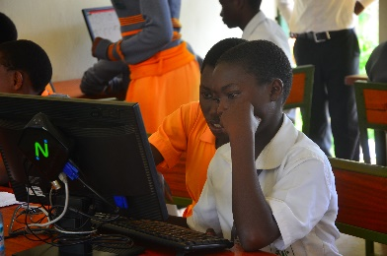
Who we are looking for
Someone who has .. Bachelors in Education Minimum of two years’ experience serving as a school leader Experience in delivering training to school leaders and teachers Background knowledge in Child Protection and Safeguarding practices Experience working in rural communities and passion for work in the field Driving license for car or motorcycle (and willingness to self-drive) Strong understanding of school governance structures in Uganda and/or previous experience in school governance Desire to learn and quickly build knowledge of international best practices across pedagogy, assessment, teacher and leader training and development. And who is... Able to analyse, interpret and use school data to inform school support Adaptable, flexible and resilient Strong communicator, able to motivate and persuade others Able to model excellent teaching and learning Independent self-motivated worker, able to tackle challenging situations with professional maturity Excellent line management skills; and/or commitment to becoming a great line manager Able to be based in rural locations, near schools with frequent travel

Slide 7
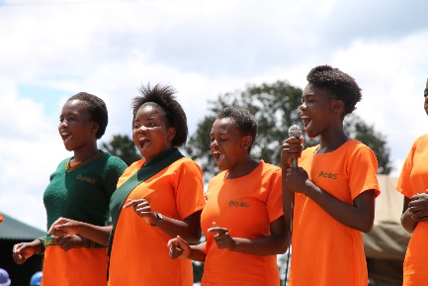
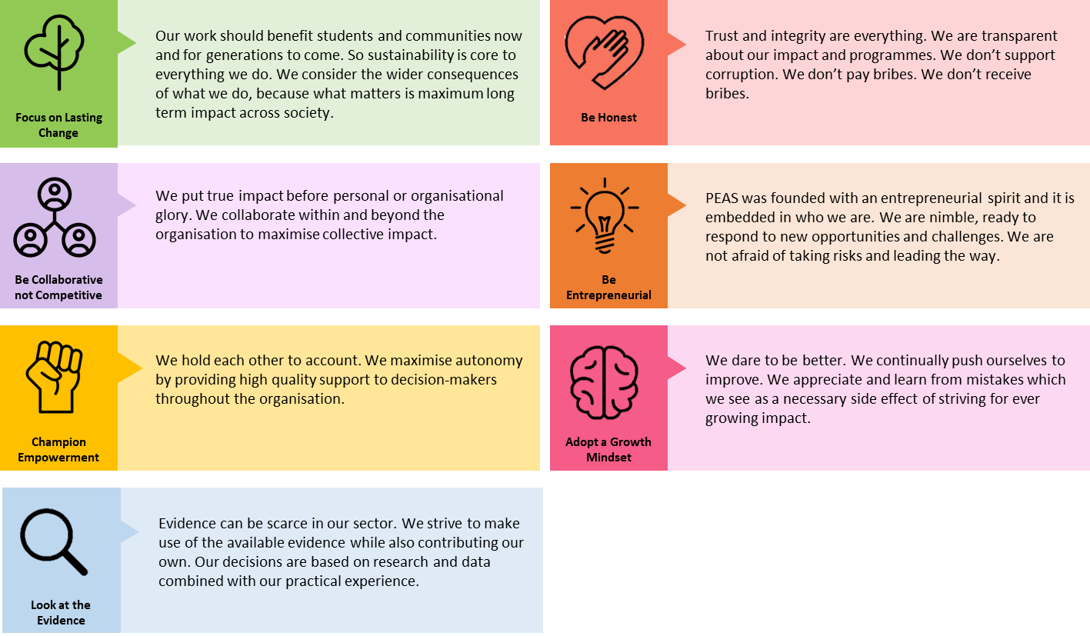
Our values
How to apply To apply, please click on the link https://tinyurl.com/3t2y3dwv to complete the application form and email your CV to recruitment-ug@peas.org.uk The closing date for ALL applications is Sunday, 21st June 2026 at 5Pm EAT . Should we receive a high number of suitable candidates. Due to high volumes of applications, if you have not heard from us within 2 weeks of the closing date, please assume you have been unsuccessful on this occasion. We are committed to ensuring our opportunities are accessible to all, so if there is any way that we can support you to be the best you can be in the recruitment process, please do get in touch by e-mail on info@peas.org.uk. We welcome all applicants and will always treat every application fairly based on merit.
PEAS is highly committed to keeping children safe from harm and preventing corruption. We therefore take our responsibility to promote safe recruitment practices very seriously, including conducting appropriate reference and background checks. We also operate a zero-tolerance approach to any PEAS employees who breach our Safeguarding and Anti-Corruption Policies, which all employees are required to sign upon induction. PEAS is an equal opportunity employer that does not discriminate in its recruitment practices and, in order to build the strongest possible workforce, actively seeks a diverse applicant pool.

