Slide 1

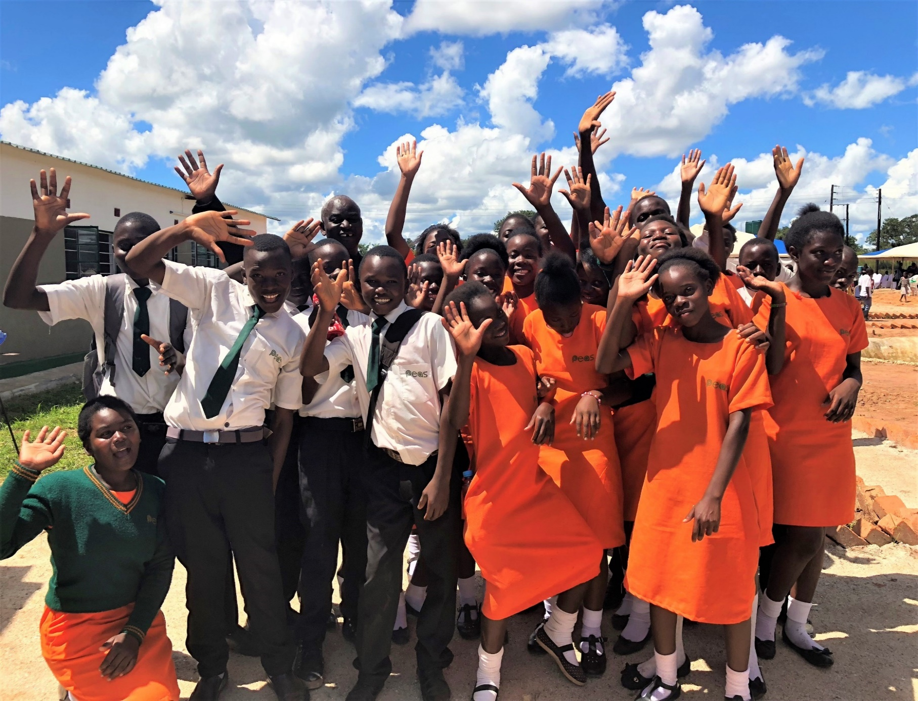



Philanthropy Lead
Candidate Pack
Our Mission
To expand access to sustainably delivered quality secondary education across Africa
www.peas.org.uk

Slide 2
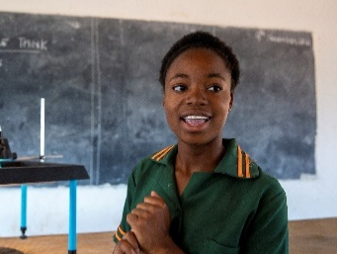

About us
2025 Job Pack Template - PL Philanthropy.pptx
PEAS is transforming education across sub-Saharan Africa. By 2030, 42% of the world’s youth will be African. Yet today, Sub-Saharan Africa has the world’s lowest secondary school completion rates. Schools are under-resourced, with low quality teaching and unsafe learning environments. PEAS is addressing this by expanding access to inclusive, quality secondary education so all children can enjoy an education that unlocks their full potential. At the heart of our work are 44 exemplar PEAS schools, delivering outstanding and affordable education to 25,000 young people in hard-to-reach communities across Uganda and Zambia. But if all children are to benefit, that doesn’t go far enough. So, we draw on our 16 years practical experience to partner with governments to design, deliver and embed country-wide meaningful changes to improve eduction. This year we will support over quarter of a million young people in Uganda, Zambia and Ghana. Evidence shows our students come from poorer households, feel safer and make faster learning progress. Our girls are more confident and better equipped for life after school. We achieve all this at a lower cost than alternatives.
What makes PEAS different?
Reducing reliance on international aid:
  Philanthropic funding means our schools open debt free they then generate local income to cover ongoing running costs
  Our system strengthening programmes are co-designed with government to fit within ministry budgets
Rooted in local expertise, delivering global excellence:
Our schools and country offices have always been fully staffed and led by Africans.
We are governed by a Board that is majority African and female, with a majority African Global Leadership Team
Our award-winning programmes are created by Africans, for African communities, and shaped by the voices of those they serve

Slide 3
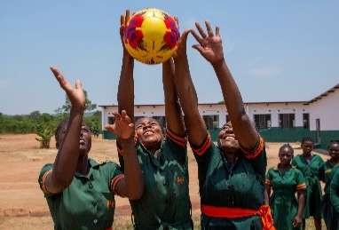
The Opportunity
.
Role and department | Philanthropy Lead – Partnerships Team (reporting into the Head of Partnerships)
Contract | Permanent
Compensation | Salary range from £40,600 – 45,600 (dependent on experience) includes % London weighting
Location | Hybrid. 2 days per week in London Office (Bermondsey). Some travel (1-3 trips per year) to Uganda, Zambia and Ghana will be required.
Start date | Immediately
About PEAS Partnerships Team
The PEAS Partnerships Team is a small team of fundraisers at the heart of PEAS’ funding engine. What makes PEAS fundraising so successful is our ‘everyone’s a fundraiser’ approach which embeds fundraising into every teams’ objectives. This means we are supported by a wider team of colleagues (Operations, Technical and in-country teams) to raise in excess of £7M per year. Last year we formed a game changing partnership with Impact Network in New York. We work hand in hand with the US team to grow our income from Philanthropy in the US.
PEAS Partnerships Team:
Comprises a Head of Partnerships, 2 Partnerships Lead (including this role) with specific areas of focus and 2 Partnerships Officers
Has overall responsibility for raising the income required to deliver PEAS ambitious global growth strategy. In 2025 this equates to £7.6 million (£5.2 OPEX and 2.5 CAPEX)
Has direct responsibility for raising funds from corporates, trust and foundations, major donors and individuals
Supports other teams to raise income from technical foundations, institutions and funders based in the countries where we operate (currently Uganda, Zambia and Ghana, with ambitions to enter into new geographies in coming years).
Has a strong focus on diversification. Since 2019, we have reduced reliance on institutional grants from 50% of annual operating income to less than 25%. We did this by increasing our corporate and individual portfolio and trialing innovative social financing models.
Is innovative and entrepreneurial. We’re continuing to build financial resilience through further diversification e.g. building a legacy programme, engaging diaspora communities in the UK and US, and building presence in African and Asian philanthropic circles.
Leads and manages PEAS external communications including branding and language, the website, newsletters, social media, publications, case studies and films.
The Opportunity
The Philanthropy Lead role is an exciting opportunity to support PEAS in crucial areas during a period of growth. This will involve working closely with teams in the UK, US, Uganda, Zambia and Ghana to shape and grow our fundraising strategy as we prepare for scale. We are looking for an ambitious, entrepreneurial and creative fundraiser. Someone who is not afraid to take risks and try new things. With a track record of finding and securing income from philanthropists, individuals and private foundations. If that sounds like you, we’d love to hear from you.

Slide 4
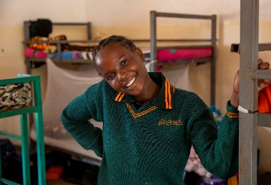
Responsibilities of the Role
As Partnerships Lead – Philanthropy, you will play a critical role in growing PEAS income from Philanthropists and Private Foundations, as well as supporting more generally on new partnerships. You will be part of a small global team (line managing one), contributing new ideas, networks and results to help us meet our income targets. 1. Building new philanthropic partnerships and funding opportunities (60%) Create and cultivate a robust major donor pipeline through prospect research, network mapping, networking and cross-collaboration with other teams and PEAS supporters. This will involve: Monitoring the fundraising ecosystem, conducting in-depth prospect research and engaging in proactive outreach campaigns through LinkedIn, emailing, networking and events. Collaborating with the Head of Partnerships to develop a Philanthropy strategy, including setting conversion objectives and evaluating and monitoring the ROI of events and campaigns. Working closely with leadership, fundraising colleagues and departments across the charity to align fundraising efforts with organisational priorities. Preparing compelling fundraising communications, pitches, proposals and presentations for prospective donors to secure new support. Maintaining high discipline and consistency in follow-up with leads and donors and using PEAS CRM (salesforce) to record up to date donor information and actions Work closely with PEAS Partnerships Lead to identify opportunities to leverage support from corporate and other contacts or vice versa 2. Growing existing relationships with PEAS major donors and emerging major donors (30%) Deepen and grow PEAS relationships with major donors and individuals to ensure a a 90%+ renewal rate. This will involve: Developing cultivation plans for PEAS’ current major donors and individuals through a variety of activities such as sharing engaging communications, impact data and monitoring reports, hosting events and school visits, and holding regular calls and face to face meetings Support the CEO and Head of Partnerships with a subset of donors by preparing comms, impact data, reports, meeting briefings and timely reminders for engagement Act as the main contact point for a subset of donors (could include major donors, trust and foundations and corporates) Enhancing PEAS communications and engagement activities (10%) Develop a calendar of engagement opportunities. This would include (but is not limited to): Creating a calendar of events (e.g. drinks receptions, breakfasts and webinars) as well as the themes and content to align to funder interests. Partnerships Officers will support on logistics. Supporting PEAS Ambassadors and in-country colleagues to host their own events. Working with PEAS Communication Officer and in-country teams to collect stories, sound bites, photos and videos that can be used to engage a variety of audiences Collaborating with PEAS US to share ideas that can be used and adapted for the US/UK context. PEAS has a collaborative and supportive environment with everyone working towards the same goal. At times you will be required to pitch in to help others, and they’ll do the same for you.

Slide 5

Who we are looking for
Someone who has .. Strong experience in fundraising with a track record of asking for and securing major gifts Proven track record of finding new funders through your own or other’s networks Demonstrable experience of running successful major donor stewardship and cultivation programmes and building donor relationships Experience designing and running a successful events programme including developing engaging content (speeches, marketing materials, videos etc) Experience working with international teams to facilitate gathering content for funder communications and knowledge of ethical communications practices (desirable) Strong writing skills with the ability to take detailed technical documents and turn them into attention grabbing communications suitable for a non-technical and time poor audiences. Demonstrable people skills and a confident, proactive, persuasive approach to fundraising, with the ability to engage and maintain relationships with a variety of stakeholders Proficiency in Microsoft Office 365 (Word, PowerPoint and excel – essential) and Salesforce (preferable) . An understanding of, and ideally relevant experience in, Sub-Saharan Africa (preferable) And who is... A self-starter – adaptable, shows initiative and is proactive in finding solutions Creative and resourceful – able to find ways to deliver high returns on a small budget Resilient and professional – works well under pressure, deals with challenges professionally and calmly and doesn’t let setbacks hold them back Open minded – willing to listen to others and consider new ways of approaching problems Zero ego – prepared to get stuck in, and be a bit scrappy when needed A good storyteller – able to bring our work to life through powerful storytelling A good listener – can quickly understand donor needs and adapt their approach accordingly Thorough – strong attention to detail and can write accurate and compelling documents Working at PEAS No matter what the role, team, context or country, we are all guided by our values, intrinsically motivated and energetic. Have impact - opportunity to really stretch yourself and contribute to having real impact in improving the life chances of all children through educational opportunity. Part of the PEAS Pod - joining a small team who are extremely effective, proactive, supportive and values aligned Collaborative cross-organisation working style - enables employees to develop skills and knowledge outside of their core role Flexible working – we are open to discuss any possible flexible options with employees. Annual leave - 28 days for full-time employees, pro-rata for part-time plus bank holidays Pension - Eligible employees are auto-enrolled into PEAS contribution-based pension scheme with up to 6% matched employer contributions Wellness and wellbeing – Employees have access to an employee assistance programme for you and your immediate family 24hrs a day, 365 days of the year

Slide 6

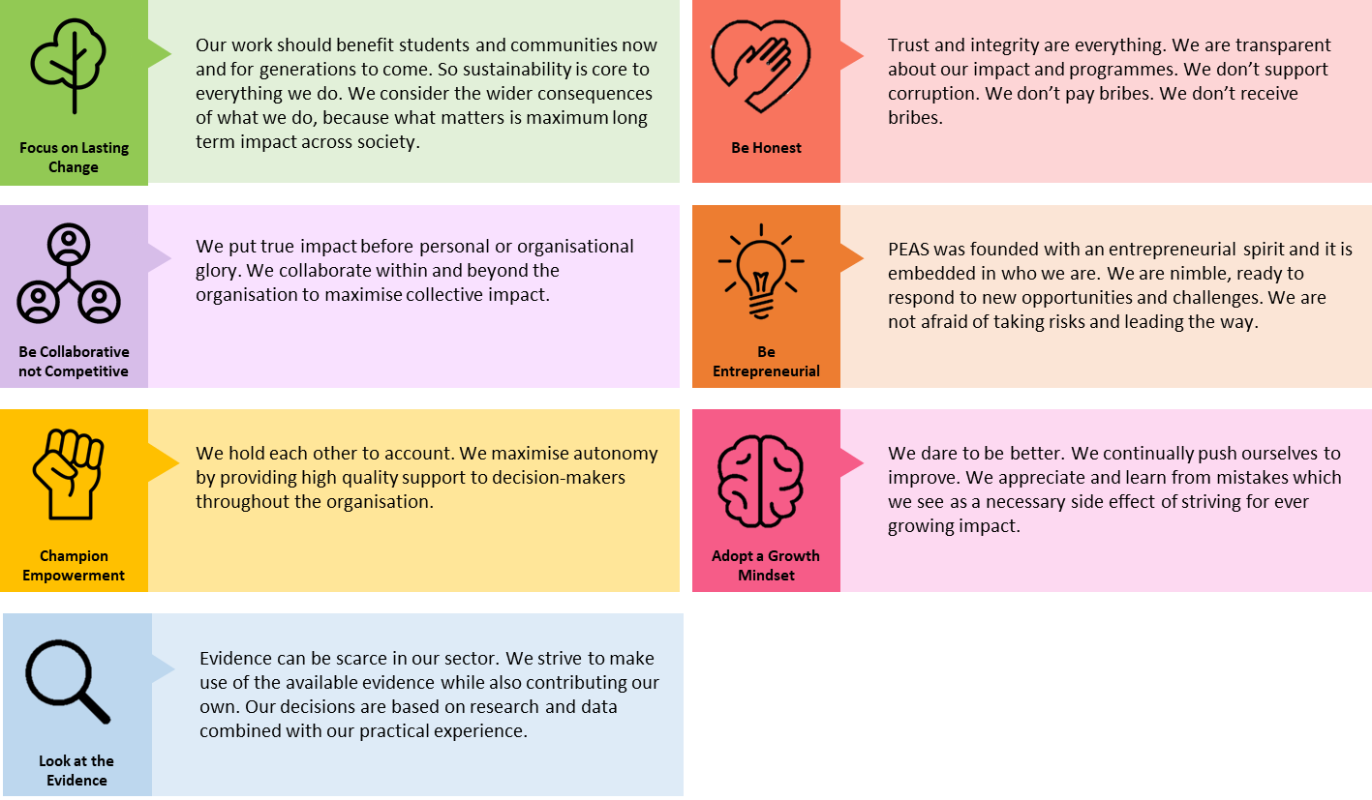
Our values
How to apply To apply, please contact Heather Burgess at Ashby Jenkins Recruitment – heather@ashbyjenkinsrecruitment.co.uk or for an informal call 0203 006 2787 The closing date for ALL applications is Friday 15th August at 10am BST. We will review and shortlist applications on a rolling basis and may close the application process sooner that the date specified should we receive a high number of suitable candidates. Due to high volumes of applications, if you have not heard from us within 2 weeks of the closing date, please assume you have been unsuccessful on this occasion. We are committed to ensuring our opportunities are accessible to all, so if there is any way that we can support you to be the best you can be in the recruitment process, please do get in touch We welcome all applicants and will always treat every application fairly based on merit.
PEAS is highly committed to keeping children safe from harm and preventing corruption. We therefore take our responsibility to promote safe recruitment practices very seriously, including conducting appropriate reference and background checks. We also operate a zero-tolerance approach to any PEAS employees who breach our Safeguarding and Anti-Corruption Policies, which all employees are required to sign upon induction. PEAS is an equal opportunity employer that does not discriminate in its recruitment practices and, in order to build the strongest possible workforce, actively seeks a diverse applicant pool.

